Slide 1
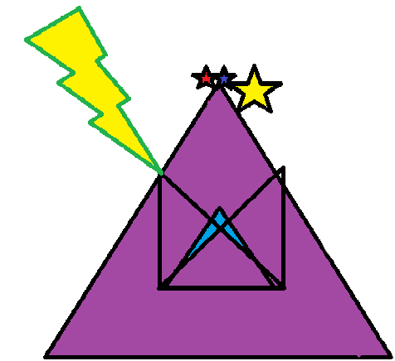

SPEED SNAIL
PERPEND STONE
CONNER JOSEPH BREWSTER
DEVON S. CHAO
JONATHAN V. NGUYEN

Slide 2
AGENDA
Specifications
Algorithm
Demo
Why we are the absolute best
Statistics

Slide 3
SPECIFICATIONS
Our Speed Snail uses a jetpack to dodge obstacles
Stay alive as long as possible while score increases.
There are power-ups that increase movement speed, missile count, and score multiplier
The game will follow a similar format to Dodger, but way more dynamic.

Slide 4
ALGORITHM
Execute the beginning screen which includes our group members and company name
Proceed to the instruction screen which informs the player how to play the game
Next go to the start screen which will have a creative screen of the game
Start playing the game which the player controls an animated snail
In order to stay alive and build score the snail must dodge the salt missiles
The player, snail, can gather 2 different orbs to gain an advantage
The red orb will speed the player up and the rate of score
The green orb will give the player extra points
In order to move up level 2 the player must exceed 10000
In level 2 the background and the missiles change
All the same mechanics apply to level 2
The player can unlock the endless mode once they exceed the score 25000
In endless mode, the game will not end until the player dies from colliding with a missile, but in this mode you can achieve high scores

Slide 5

DEMO

Slide 6
WHY IS OUR PRODUCT THE BEST?
We here at Perpend Stone feel that innovation is key to our survival. We strive for nothing less than the best.
We have graphics that have no equal comparison.
Music that soothe you as you live life on the edge as a jetpack riding snail.
We have a reasonable price of $9.99

Slide 7
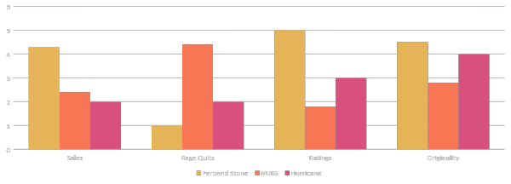
STATISTICS

